Slide 1
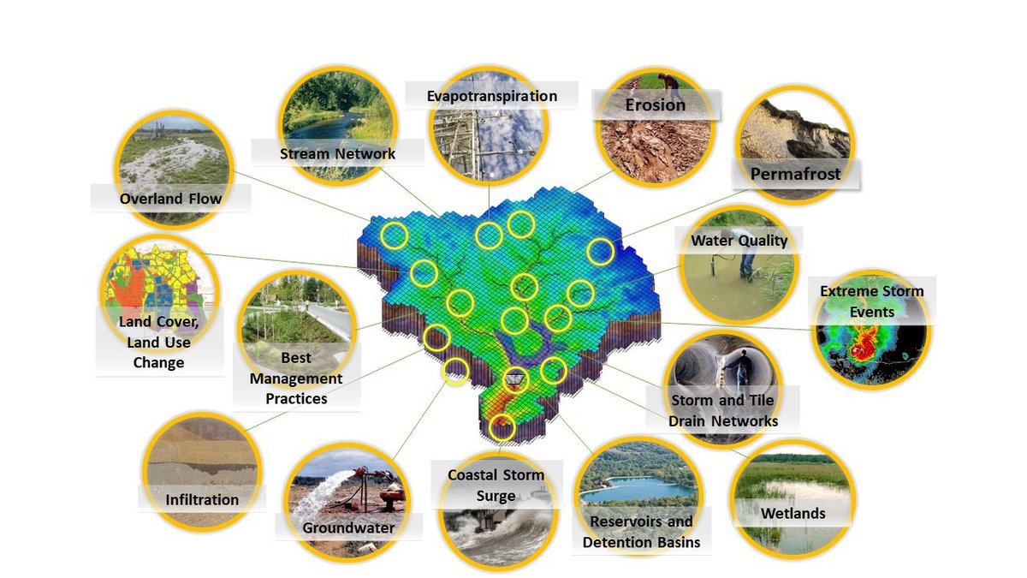
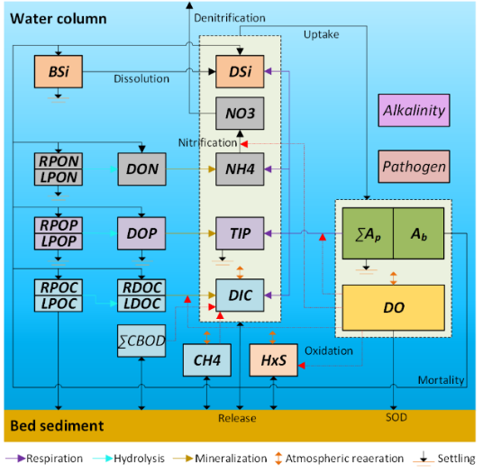
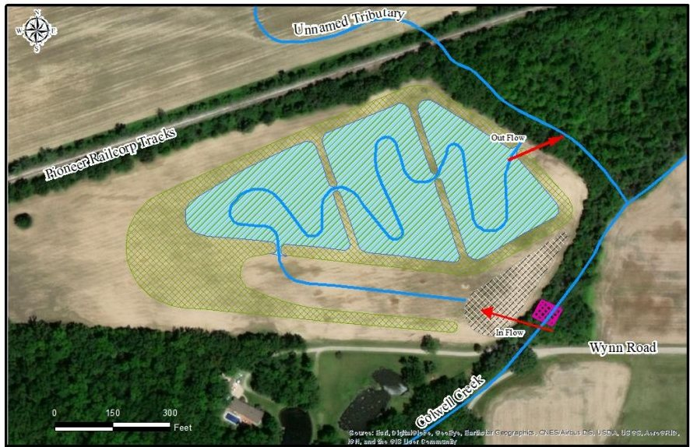
EWN FY24 End of Year In-Progress Review
UPDATE THIS PHOTO
Name of Project: Utilizing EWN for Water, Sediment, and Contaminant Management in Agricultural Areas in the Midwest and Great Plains Regions
Project Code: ERT-23-12
PI Name(s): Todd Steissberg, Chuck Downer, Aaron Byrd, Rose Shillito, Nawa Pradhan
Funding per FY ($K, add/remove columns as needed)
FY22 | FY23 | FY24 | FY25 | FY26 | TOTAL
$0K | $180K | $20K | $250K | $200K | $650K

Slide 2
ERT-23-12: Project Objectives
The broad objective of this project is to facilitate the use and design of sustainable EWN projects in intensively hydrologically altered agricultural areas in the Great Plains and Midwest regions. We intend to advance the use of EWN in these areas by developing and demonstrating an analysis tool to identify the potential for EWN to provide benefits for water bodies in the regions.
Develop an advanced modeling tool, the EWN Engineering Design Tool, will allow farmers to:
Optimize operations (e.g., tillage practices)
Application of fertilizers
Design tile drains to more efficiently remove water from fields
Mitigate excess suspended sediments, nutrients, and chemicals to downstream waterbodies through the use of EWN features such as constructed wetlands, bio-swales, etc.
Develop a demonstration study to verify that the model is performing satisfactorily and will meet the needs of agricultural land managers.
Notes:
Describe the project objectives as described in the PMP, using a few bullets. Add a couple of project photos. If you’d like to share additional photos, please put these in the last slide of this slide deck.

Slide 3
ERT-23-12: Research Deliverables
Deliverables | Completed (Y/N) | If no, anticipated date? | Sent to EWN Comms? (Y/N)
Develop Design Plan for integrating nutrient and contaminant processes with Super Link and Vadose Zone within GSSHA using the Basic Modeling Interface (BMI) | Y |  | N
Develop transport simulation capabilities in the vadose zone and tile drain networks for suspended sediments, nutrients, and contaminants | N | 30 Sep 2025 | N
Integrate ERDC’s Nutrient Simulation Module (NSM) with GSSHA’s Vadose Zone module | N | 30 Sep 2025 | N
Integrate USGS’s PHREEQC biogeochemistry model with Vadose | N | 30 Sep 2025 | N
Integrate NSM with GSSHA’s Super Link | N | 03 Mar 2026 | N

Slide 4
ERT-23-12: Research Deliverables
Deliverables | Completed (Y/N) | If no, anticipated date? | Sent to EWN Comms? (Y/N)
Integrate PHREEQC with GSSHA’s Super Link |  | 03 Mar 2026 | N
Develop time-varying ground conditions |  | 03 Mar 2026 | N
Test and debug GSSHA-NSM |  | 30 Sep 2026 | N
Test and debug GSSHA-PHREEQC |  | 30 Sep 2026 | N
Develop case study | N | 31 Mar 2025 | N
Publication: Technical note on tile drain water quality | N | 30 Nov 2024 | N
Publication: EWN Design Tool | N | 30 Sep 2026 | N

Slide 5
ERT-23-12: Project Highlights in FY24
Technical Note (in prep.): Effects of agricultural tile drains on water quality
GSSHA water quality development:
Developing Basic Modeling Interface (BMI) linkage between GSSHA and the USGS PHREEQC biogeochemistry modelCode development collaboratively managed within a private GitLab repository: https://public.git.erdc.dren.mil/GSSHA/gssha
Developed a GSSHA water quality Case Study model using the Joe Pool Reservoir and Drainage area in the Trinity River Watershed, Texas
Developing a geochemical reactive transport test case to demonstrate the BMI-based coupling of the PHREEQC geochemical reaction model with GSSHA's constituent transport capabilities
Developing coupled GSSHA-PHREEQC test cases with domains sized to visualize contaminant transport and to run in seconds or minutes
Developing demonstration capabilities of the GSSHA-PHREEQC BMI (Basic Modeling Interface)
Developed capability to read GSSHA inputs/outputs into Python Xarray datasets
Expanded the documentation for the PHREEQCRM BMI example Jupyter Notebook
Adapting PHREEQC BMI demo notebook for use with Python's Xarray library
Testing the GSSHA BMI
Notes:
Describe the current project highlights, including major events, activities, deliverables, and/or accomplishments. Include the date of achievement/completion for each highlight.

Slide 6
ERT-ASU-04: Status of Project Activities (Thru FY24)
Activity | Deliverable | Communication/Technical Transfer Plan | Lead POC | Anticipated Start Date (quarter and year) | Anticipated End Date (quarter and year)
Task 1. Develop Design Plan for Integrating nutrient and contaminant processes with Super Link, Vadose zone, and Groundwater within GSSHA | Design document for use in directing integration activities. | Published ERDC Technical Report | Todd Steissberg | 3rd/FY23 | 4th/FY23
Task 2. Develop transport capabilities in the Vadose zone and tile drain networks for suspended sediments, nutrients, and contaminants | Updated GSSHA Model | ERDC GitHub Site, Coastal and Hydraulics Laboratory Web Site | Chuck Downer | 3rd/FY23 | 2nd/FY24
Task 3. Integration of NSM with Vadose zone module | Updated GSSHA model | ERDC GitHub Site, Coastal and Hydraulics Laboratory Web Site | Chuck Downer | 3rd/FY23 | 2nd/FY24
Task 4. Integration of CSM with Vadose zone module | Updated GSSHA model | ERDC GitHub Site, Coastal and Hydraulics Laboratory Web Site | Chuck Downer | 2nd/FY24 | 1st/FY25
Task 5. Integration of NSM with Super Link | Updated GSSHA model | ERDC GitHub Site, Coastal and Hydraulics Laboratory Web Site | Chuck Downer | 3rd/FY24 | 2nd/FY25
Task 6. Integration of CSM with Super Link | Updated GSSHA model | ERDC GitHub Site, Coastal and Hydraulics Laboratory Web Site | Chuck Downer | 1st/FY25 | 4th/FY25
Task 7. Development of time varying Ground Concentrations | Updated GSSHA model | ERDC GitHub Site, Coastal and Hydraulics Laboratory Web Site | Chuck Downer | 1st/FY25 | 4th/FY25
Task 8. Testing and Debugging of NSM integration with GSSHA | Updated GSSHA model, Technical Note | Published ERDC Technical Note | Todd Steissberg | 3rd/FY25 | 2nd/FY26
Task 9. Testing and Debugging of CSM integration with GSSHA | Updated GSSHA model, Technical Note | Published ERDC Technical Note | Todd Steissberg | 3rd/FY25 | 2nd/FY26
Task 10. Development and Execution of Seven Mile Creek Demonstration Study | Seven Mile Creek GSSHA model, Technical Report | Published ERDC Technical Report | Nawa Pradhan | 1st/FY26 | 4th/FY26
Task 11. Conferences/Journals | Conference Papers, Journal Articles | Conference Publications and Presentations, Published Journal Articles | Todd Steissberg | 1st/FY26 | 4th/FY26
Task 12. Workshop with USACE District Personnel | Workshop | Workshop | Chuck Downer | 1st/FY26 | 4th/FY26
Notes:
Complete this table for your project. Include all activities and deliverables, including ones that were modified or deleted, as well as ones that were added along the way. Use the notes column to add additional explanation or notes on modifications in the activities, deliverables, or start/end dates.
Use multiple tables/slides if needed.

Slide 7
ERT-23-12: Delays and difficulties
Case study development was paused to focus on BMI development to link GSSHA with NSM and PHREEQC
FY24 tasks were paused due to budget cuts. LimnoTech continued to make progress on model capability and case study development under a task order funded in FY23.
If funding is available in FY25, ERDC plans to continue development as planned in the PMP.
Notes:
Please include a bullet list of delays and/or difficulties with project activities or deliverables. Indicate how delays/difficulties are being addressed and managed, and the anticipated dates for getting back on track.

